Slide 2
Learning objectives
LO1: Understand the purpose and properties of digital graphics
LO2: Be able to plan the creation of a digital graphic
LO3: Be able to create and save a digital graphic
LO4: Be able to review the digital graphic

Slide 3
Learning objective 1
Investigate digital graphics
You have 4 tasks to complete for LO1 which should be completed in one presentation called investigating digital graphics.
You should save this work for this section into
- R082
- Learning Objective 1

Slide 4
Task 1 a
Create a spider diagram of as many different types of graphics that you can think of. E.g. magazine covers, adverts, posters, cartoons, web, images.

Slide 5
Digital graphics
Book covers

Slide 6
Book covers

Slide 7
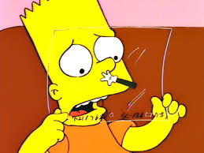
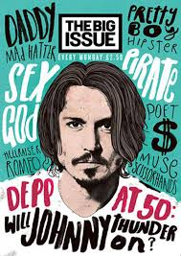
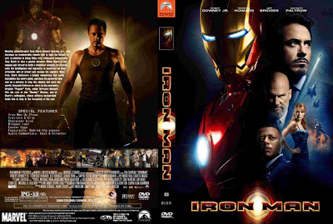
Starters – different images

Slide 8
Task 1 b
Pick five of these different types of graphics to expand on:
1. Show some examples.
2. How are they used? – Electronic or Print or both.
3. What is their purpose? e.g. entertainment, information, education, advertising.

Slide 9
Book covers
How are graphics used
Why are graphic used
Electronic form in kindles
Printed in paper/ hard back books
Describe the story is like (dark horror)
Attract a particular reader
The purpose of the graphics
Make the reader want to read the book
Promote the Author and publisher

Slide 10
Book covers
Book covers can use the digital graphic in print book or in electronic form such as a kindle. They can be put in shop windows to entice people in to the shop this may attract a particular audience e.g the Jurassic park cover would attract people how liked dinosaurs. The book cover also promotes the author and the publisher and describes the type of story the that reader might find e.g dark covers for a horror book.
The purpose of the cover is to make the reader want to read this book, to promote the author and the publishing company.

Slide 11
Task 2
Add in three slides about.
The use of colour
The use of composition
The use of white space

Slide 12
Uses of colour
To convey structure
To appeal to an audience
To create emotion/mood
To establish an identity
Notes:
http://understandinggraphics.com/design/10-reasons-to-use-color/
http://www.smashingmagazine.com/2010/01/28/color-theory-for-designers-part-1-the-meaning-of-color/
http://understandinggraphics.com/design/10-reasons-to-use-color/
http://www.creativebloq.com/branding/amazing-uses-colour-6133196

Slide 13
Colour and Emotion/Mood
Red – Action explosions/ fire & high speed action with violence
Blue – can but cold and wintery
Black – Use the colour black to convey elegance, sophistication, or mystery.
Orange – I can portray excitement or even anger
Notes:
http://www.gurl.com/ - can use this to talk about colour and composition.
http://www.teenreads.com/

Slide 14
Colour
Add a slide titled “Colour”
Choose one or two images – maybe a poster or book cover or website.
Write a few sentences on how colour has been used in the digital graphic. Eg: Is colour conveying emotion or structure or identity or enhancing the visualisation.

Slide 15
The use of white space
Make look clean
Easy to follow
Less fussy
Organized
Look more professional
…..just to confuse you – white space doesn’t have to be white!!

Slide 17
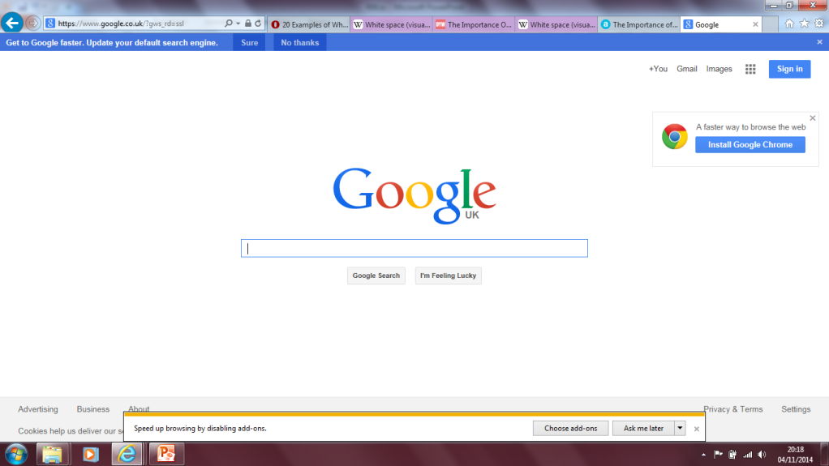
Good examples of white/Negative space
Here the white/negative space is orange giving a minimalist effect and enhancing the brand.
Notes:
http://www.ozoneeleven.com/showcases/20-examples-of-white-space-properly-used-in-web-design/

Slide 18
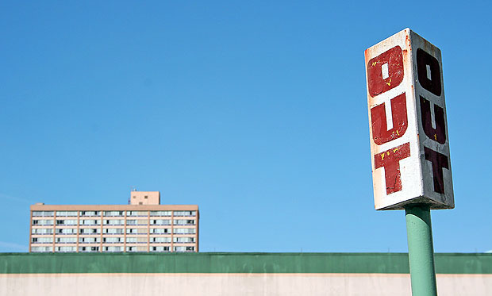
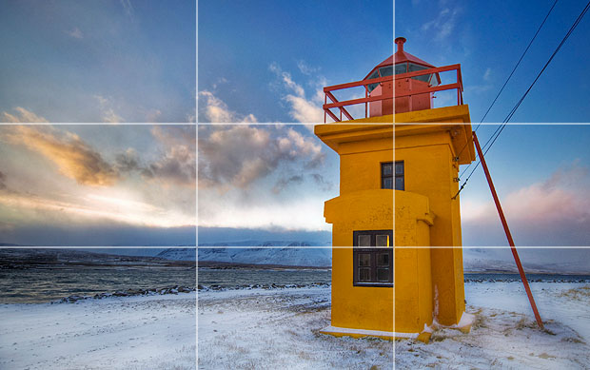
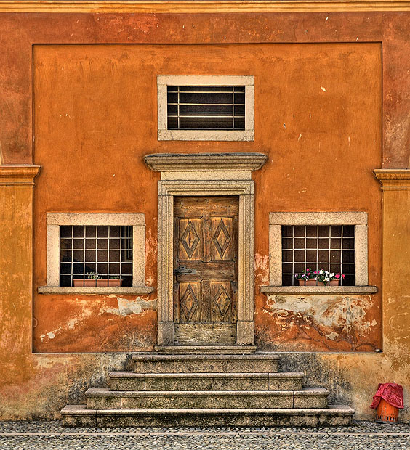
The use of composition
Use of thirds
Balancing Elements
Symmetry
Notes:
http://www.photoble.com/photography-tips-tricks/movie-poster-composition-techniques
http://www.cambridgeincolour.com/tutorials/rule-of-thirds.htm

Slide 19
Task 3
Research the properties of digital graphics and their suitability for use and explain with examples;
a) How different purposes influence the design and layout of a digital graphic
b) How the audience influence the design and layout of a digital graphic
Notes:
http://www.bbc.co.uk/schools/gcsebitesize/dida/graphics/graphic_typesrev2.shtml

Slide 20
Audience, Purpose and Genre
Digital Graphics serve a specific purpose appeal to an identified audience. For example, you may want to give the target audience tourist information, or you might be hoping to sell a product.
Therefore the graphics you use will depend on whether you want to express a formal or informal tone. The size, position, colour and composition of the image will also differ according to different audiences.

Slide 21
Audience, Purpose and Genre
Identifying the audience and catering for their needs is very important. A publication for children might include lots of cartoons, whereas a publication for adults might include photographs.
The images, content and style of writing would be very different in both of these publications.
Getting this wrong could be disastrous.

Slide 22
Task 4
Create a table with the headings
file extension
File Format
What are they used for
Good website to use
tiff
jpg
png
giff
pdf
psd
Notes:
http://www.bbc.co.uk/schools/gcsebitesize/dida/graphics/bitmapvectorrev3.shtml

Slide 23
Starter
Power point
Excel
Word
Abobe reader
.doc
.ppt
.pdf
.xls

Slide 24
Extension
To achieve a higher grade you should add more examples of your own. Make sure that the file types are all related to digital graphics.

Slide 25
Raster and vector Graphics
Give a brief explanation for raster and vector graphics.
Create a table as follows:
 | File Types | Advantages | Disadvantages
Bitmap or raster graphics
Vector graphics
Notes:
http://www.bbc.co.uk/schools/gcsebitesize/dida/graphics/bitmapvectorrev3.shtml

Slide 26
Learning objective 2
A DVD cover for ‘Energy Matters’
Your client is producing a new film and needs to begin the development of the DVD cover. The title of the film is ‘Energy Matters’ and it is about the World’s demand for energy in the year 2020. The film is expected to be given a Certificate 12 rating when released. The DVD cover produced must be a single piece of digital graphic artwork that includes front cover, back cover and the spine. A high quality file for print purposes must be created together with a low resolution version suitable for use on a website. The website version will be used for promotion and be 400 pixels wide to fit the web page layout.
The client has provided the blurb to be used on the back cover of the DVD:
Narrated by Jack Dorsey from the award winning series ‘Earth Sources’ comes the ultimate portrait of the earth’s energy consumption. This documentary conveys the use of energy today and also highlights the worlds demand for energy in 2020 and what effect this will have on the earth in the long run.

Slide 27
What I can change
Name of the film
What the film is about
Blurb

Slide 28
Your client and the target audience
You need to:
consider the client’s requirements and how these are specified
consider the target audience for the DVD cover
Decide on a visual style and composition of the digital graphic
Identify what assets and resources you will need to create the graphic
Present your findings in a report or presentation

Slide 29
A work plan created as a text table in word processing software
Activity | Duration | Resources
Find images for mood board | 1 hour | Magazines, adverts, photos
Create mood board | 1 hour | A3 paper, glue stick, scissors
Ideas for mind map | 30 mins | Pen, paper
Create mind map | 1 hour | Pen, paper
Plan visualisation | 30 mins
Create visualisation | 30 mins | Desktop Publishing software
Develop story for storyboard | 1 hour
Plan scenes and durations | 30 mins | Pen, paper
Create storyboard | 1 hour | Storyboard templates
Digitise documents | 30 mins | Scanner, digital camera
Send to client | 5 mins | Computer system with email
Obtain feedback | 30 mins
Make changes | 1 hour
Total | 9h 5mins

Slide 30
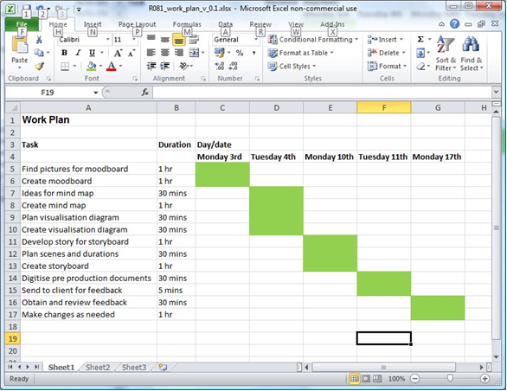
A work plan created in spreadsheet software

Slide 31
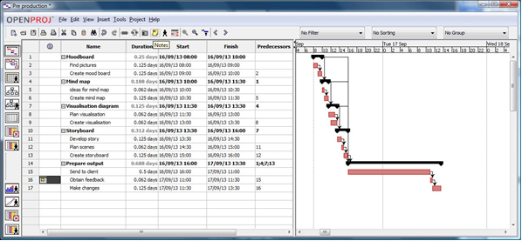
A work plan created using project type software

Slide 32
Your task
What the different tasks/activities are.
How long each one will take.
When you will be able to work on each task.
What resources your will need.
What tasks must be finished before you can start the next part.

Slide 34
Legal restrictions
You need to:
Consider any legal issues and restrictions on what you will create. The DVD cover will be used in a commercial context so copyright must be considered
Present your findings in a report or presentation

Slide 35
Learning Objective 3
Create
You will need to produce the digital graphic for the DVD cover, using a range of tools, techniques and assets to ensure it is suitable for its intended uses.

Slide 36
Obtaining assets for use in the graphic
You need to:
Either source and/or create the assets identified in your visualisation diagram
Check the properties of the individual assets to make sure they are suitable for use at their intended size in the final DVD cover. Where necessary, modify the properties to ensure their compatibility.

Slide 37
Create the graphic
You need to:
Use a range of tools and techniques from the image editing software to combine the assets into the final graphic
Save the digital graphic as a high quality format for print purposes ensuring you use version control throughout
Re-purpose the graphic as a second, low resolution version for use on the web.

Slide 38
Learning Objective 4
Review
Now the graphic for the cover of ’Energy Matters’ has been produced, you need to consider whether you have met all the requirements of the initial brief. You will also need to review the overall quality of the product, and identify any improvements that could be made.

Slide 39
Reviewing the graphic
You need to:
Make sure both of the final digital graphic formats are fit for purpose
Check that the digital graphic meets the client requirements initially specified
Review the final digital graphic in terms of composition, colours and overall quality.

Slide 40
How the graphic could be improved
You need to:
Identify how the graphic for the DVD cover could be improved, given more time, more resources or different assets.

